Slide 1

Sleep Health and Lifestyles Analysis
EDA analysis R programming by Salonee Jadhav

Slide 2
Contents of this PPT
Introduction to the dataset
EDA analysis
Objectives of the analysis
Exploratory Data Analysis to find hidden patterns , trends and relationships within datasets
Dataset in use its variable types and basic information
Multiple objectives for the analysis
Results/Conclusions
Results or conclusions derived from the dataset for respective Objectives
Used methods in
Analysis
Different procedures used in EDA

Slide 3
Introduction to the dataset:
The Sleep Health and Lifestyle Dataset has 374 rows and 13 columns, covering a wide range of variables related to sleep and daily habits. It includes details such as gender, age, occupation, sleep duration, quality of sleep, physical activity level, stress levels, BMI category, blood pressure, heart rate, daily steps, and the presence or absence of sleep disorders.
Dataset Columns: Person ID: An identifier for each individual. Gender: The gender of the person (Male/Female). Age: The age of the person in years. Occupation: The occupation or profession of the person. Sleep Duration (hours): The number of hours the person sleeps per day.
Quality of Sleep (scale: 1-10): A subjective rating of the quality of sleep, ranging from 1 to 10. Physical Activity Level (minutes/day): The number of minutes the person engages in physical activity daily. Stress Level (scale: 1-10): A subjective rating of the stress level experienced by the person, ranging from 1 to 10. BMI Category: The BMI category of the person (eg: Normal , Slightly Above Normal , Obese, Overweight). Blood Pressure (systolic/diastolic): The blood pressure measurement of the person Heart Rate (bpm): The resting heart rate of the person in beats per minute.
Daily Steps: The number of steps the person takes per day. Sleep Disorder: The presence or absence of a sleep disorder in the person (None, Insomnia, Sleep Apnea).

Slide 4
Objectives:
Relation between quality of sleep how sleeping duration | Distribution of Bmi Categories by occupation
Is there any relation between blood pressure and heart rate in both sex | Distribution of Bmi Categories by Gender
Age wise percentage distribution | What is the relationship between people with obesity and daily steps
Age wise average sleep | Mean stress for each occupation by gender
Which occupation gets the most sleep | Stress vs heart rate in occupations
The co-relation between occupation and sleeping disorder | Distribution of Sleep hours in age groups with occupation and sleep disorder
Relationship of steps and physical activity and its affect in BMI categories by gender

Slide 5


Slide 6
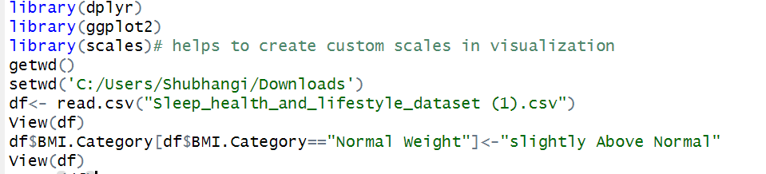
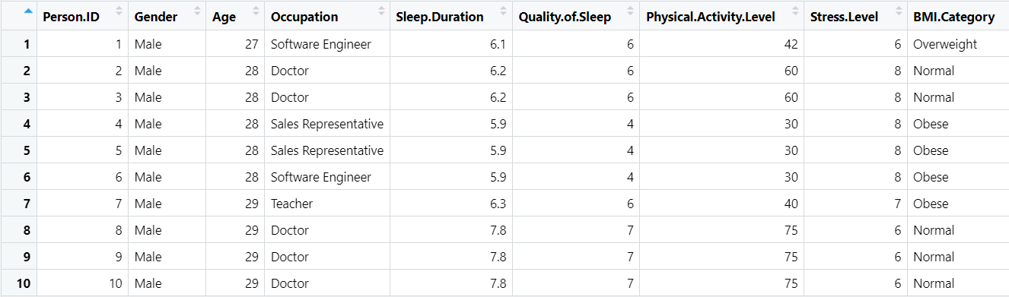
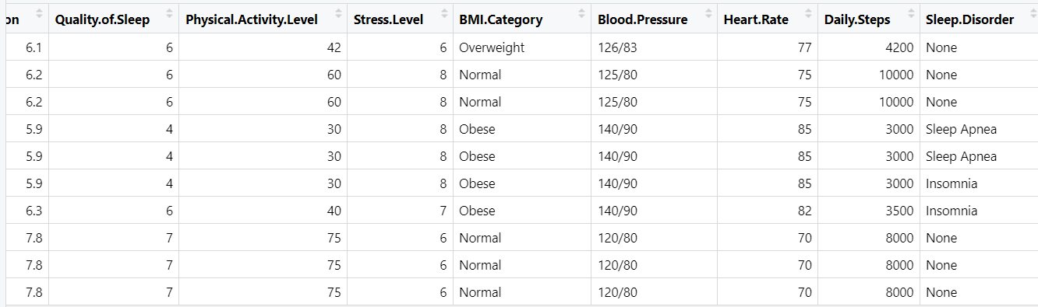

Slide 7
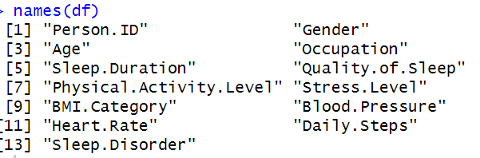
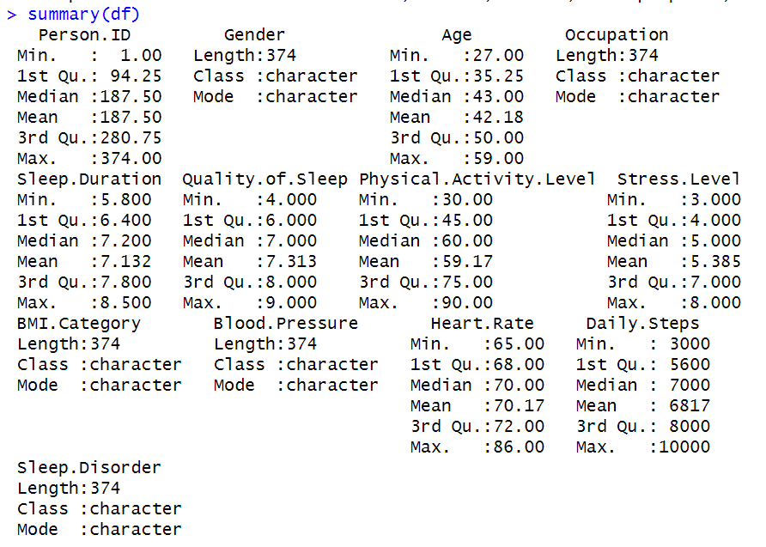
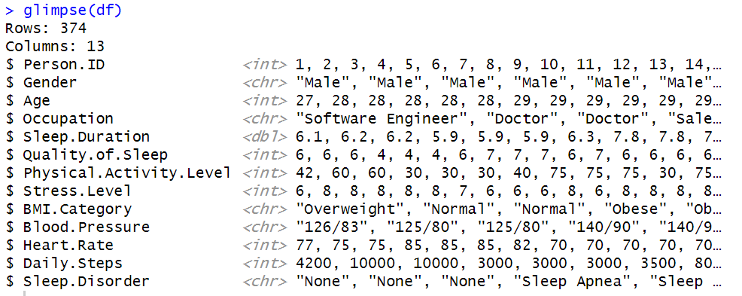



Slide 8
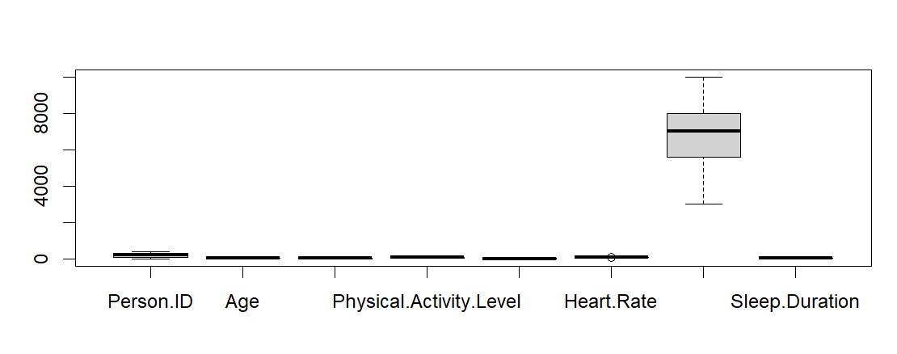

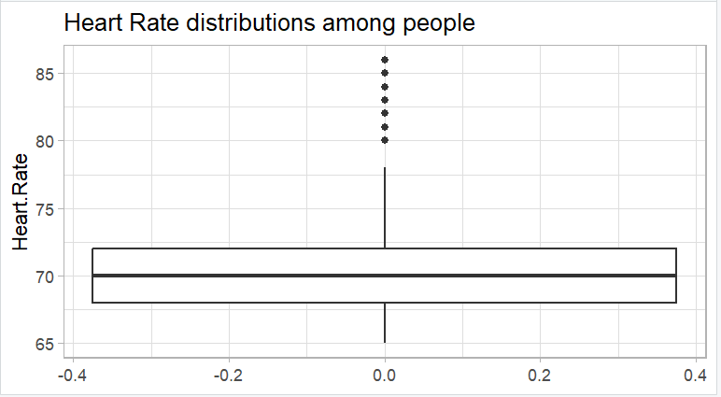
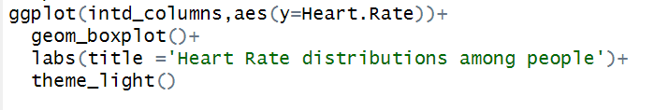

Slide 9
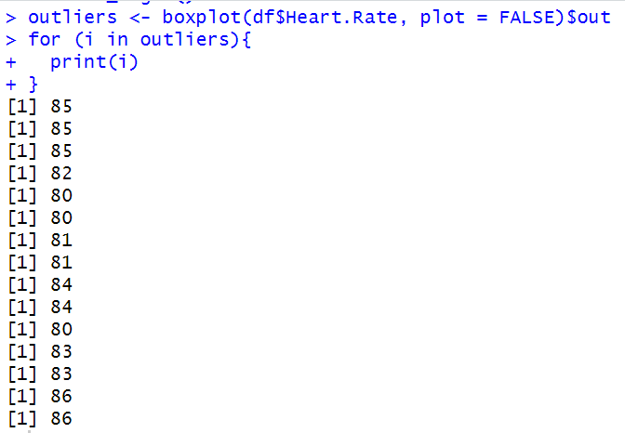
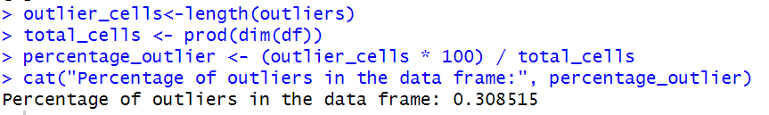
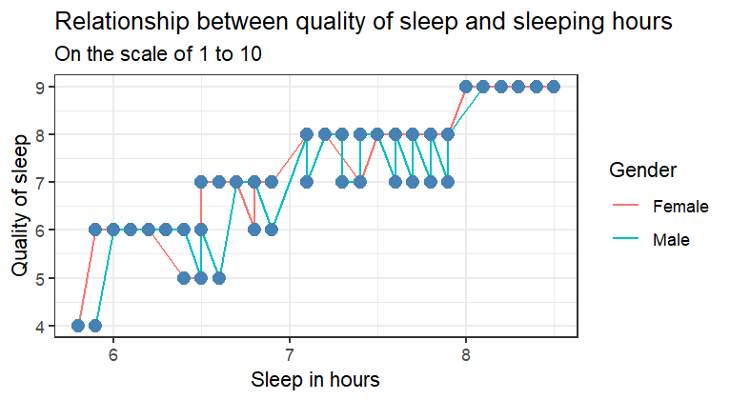
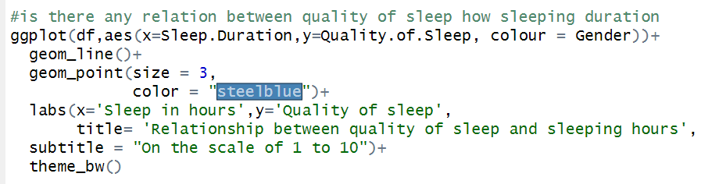
1.Relation between quality of sleep and sleeping duration

Slide 10
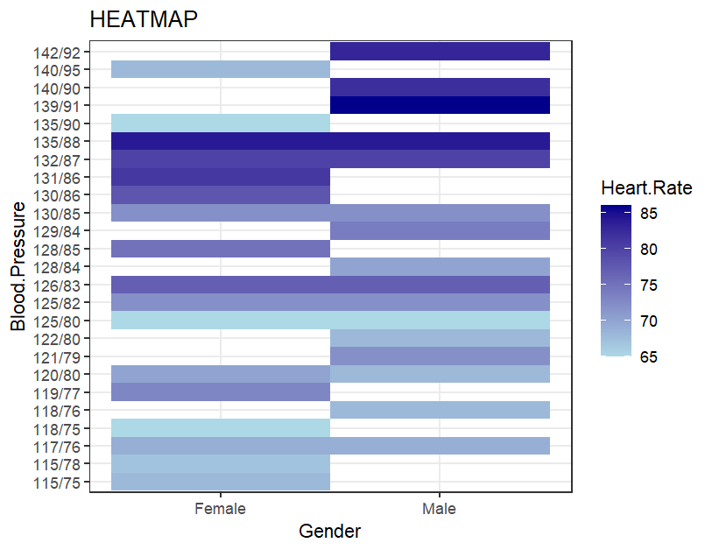
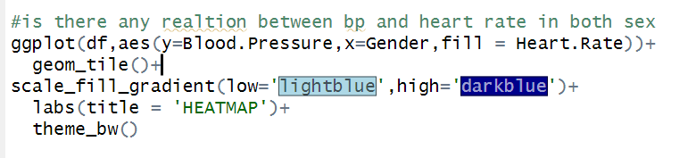
2.Is there any relation between blood pressure and heart rate in both sex

Slide 11
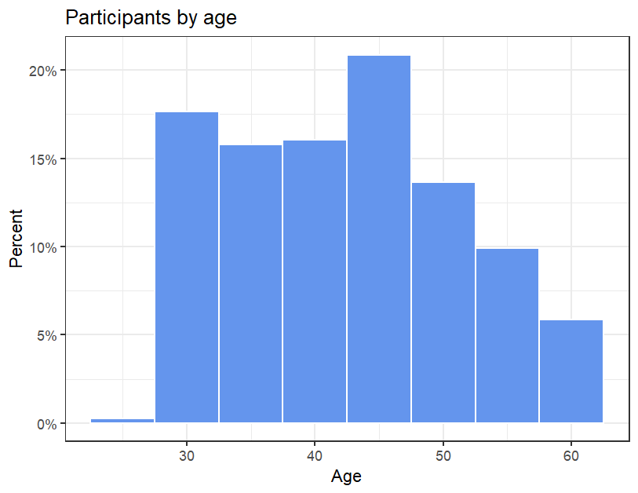
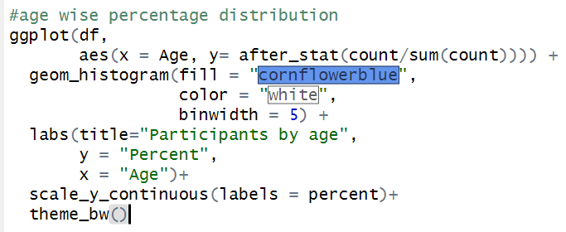
3.Age wise percentage distribution

Slide 12
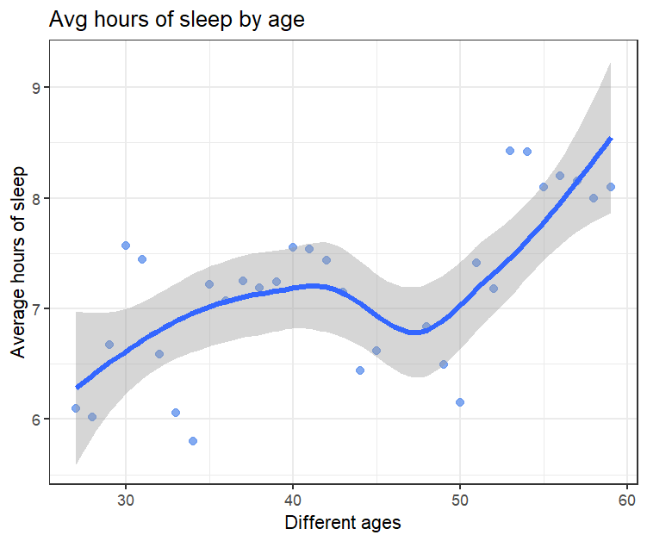
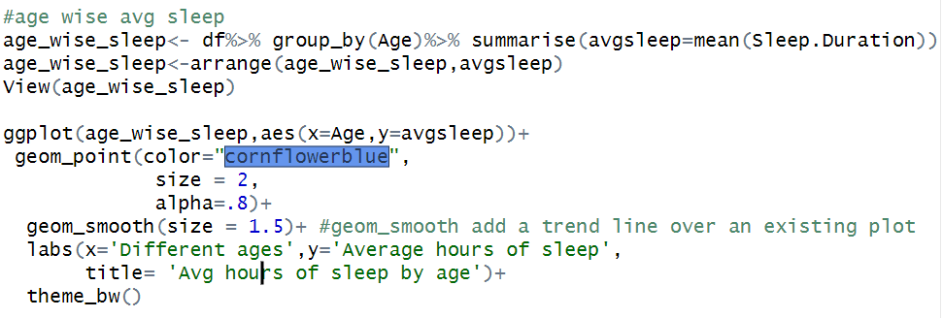
4.Age wise average sleep

Slide 13
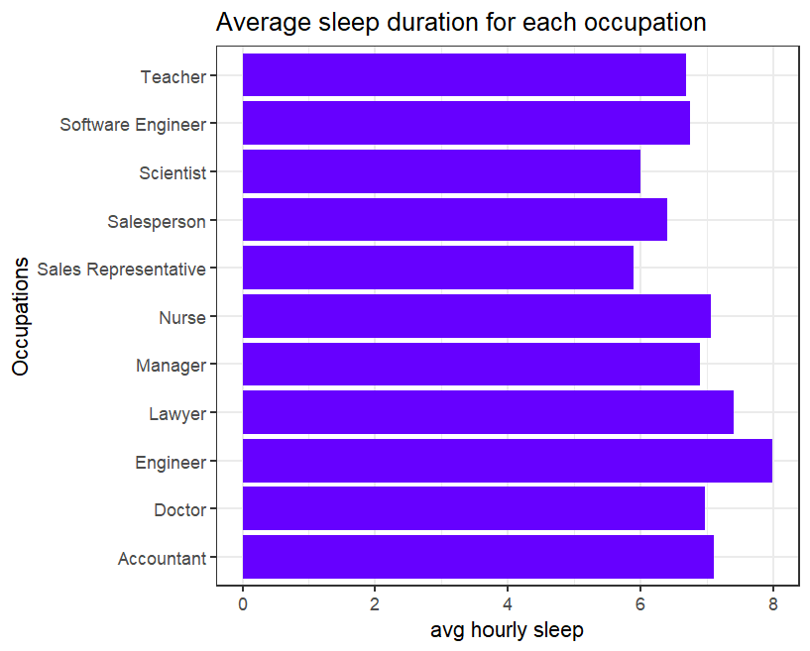
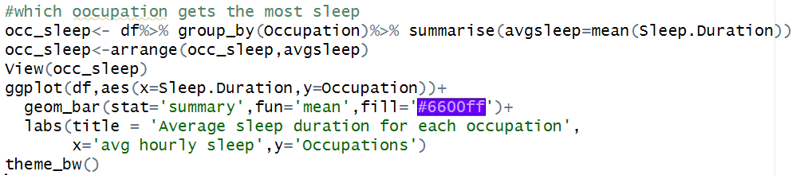
5. Which occupation gets the most sleep

Slide 14
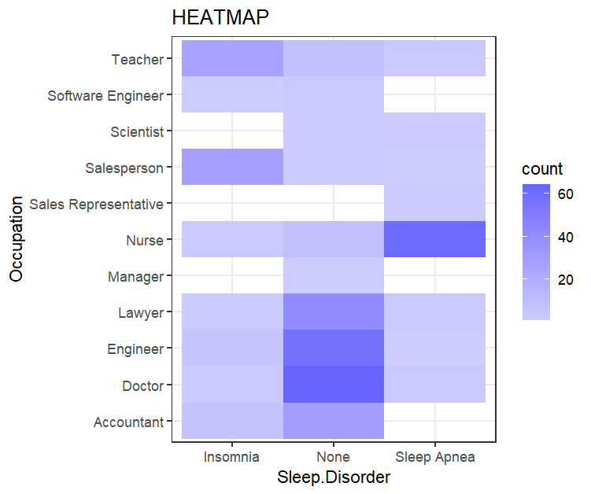
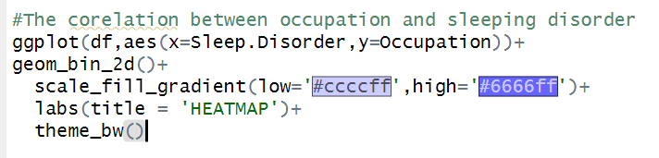
6.The co-relation between occupation and sleeping disorder

Slide 15
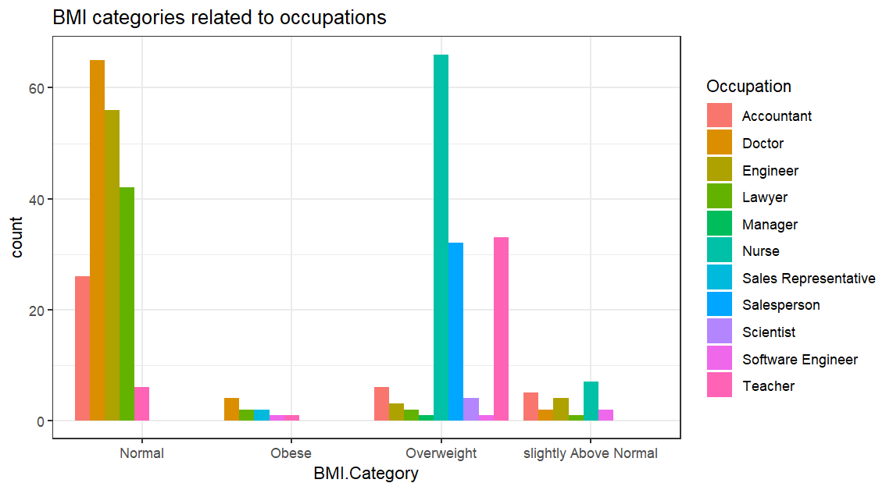
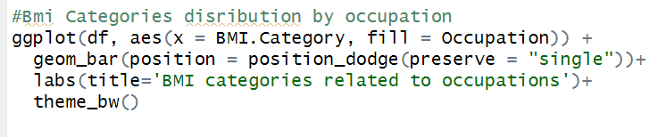
7.Distribution of Bmi Categories by occupation

Slide 16
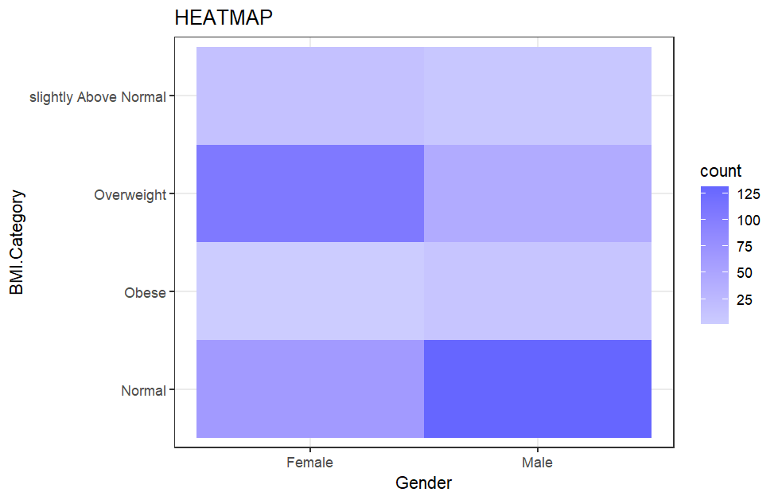
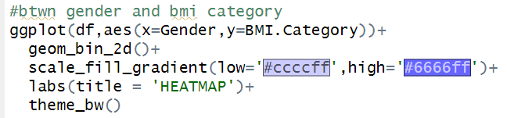
8.Distribution of Bmi Categories by Gender

Slide 17
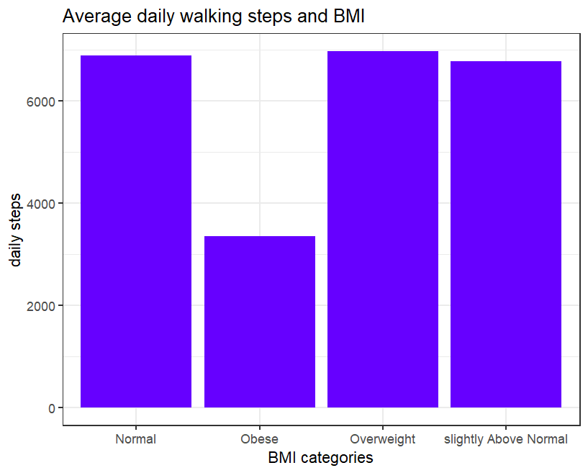
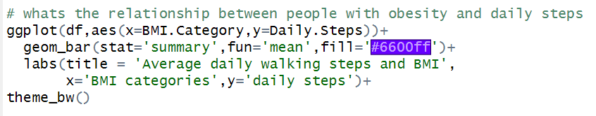
9.What is the relationship between people with obesity and daily steps

Slide 18
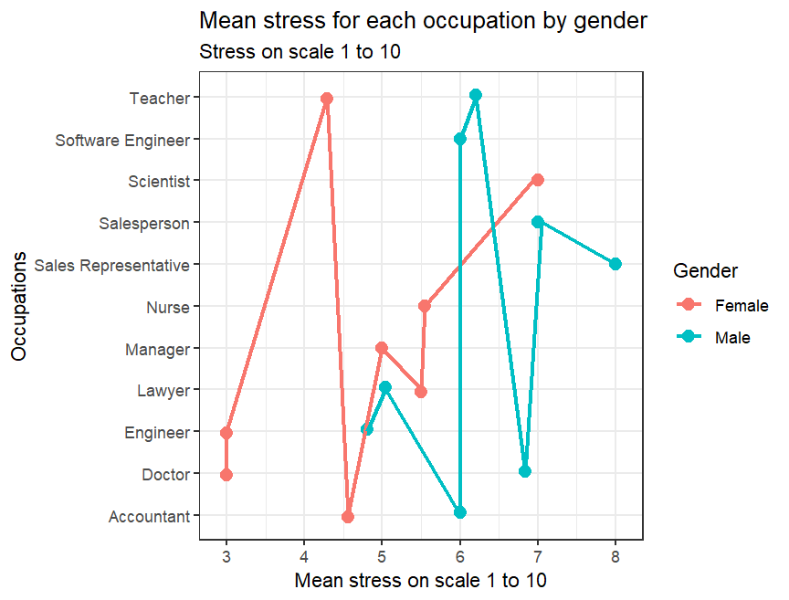
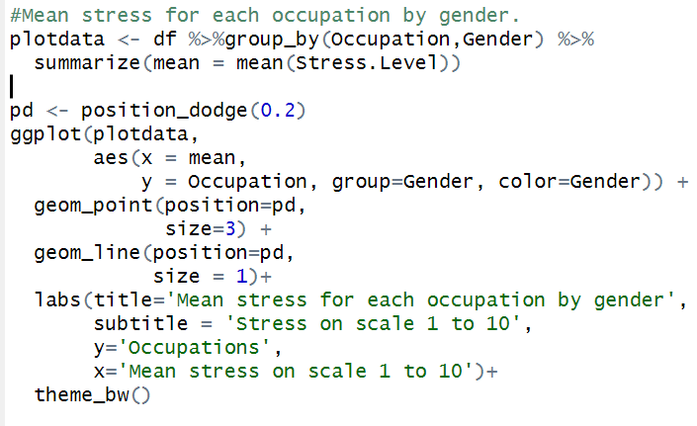
10.Mean stress for each occupation by gender

Slide 19
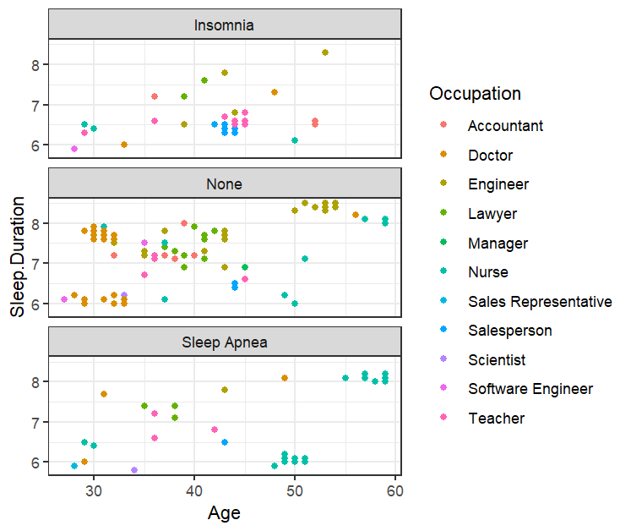
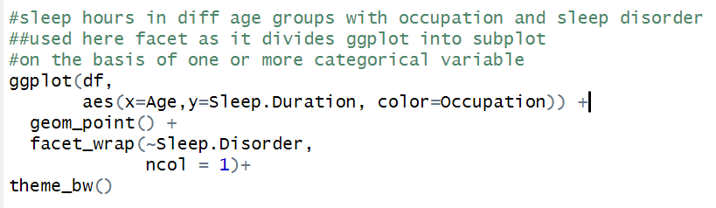
12.Distribution of Sleep hours in age groups with occupation and sleep disorder

Slide 20
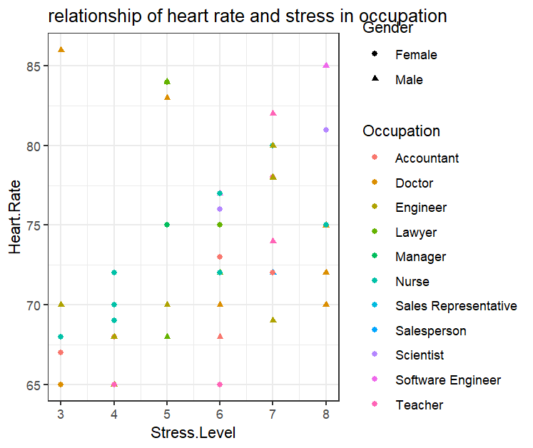
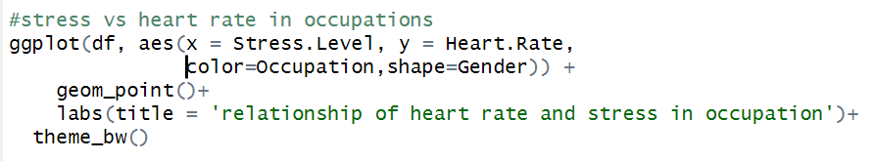
11.Stress vs heart rate in occupations

Slide 21
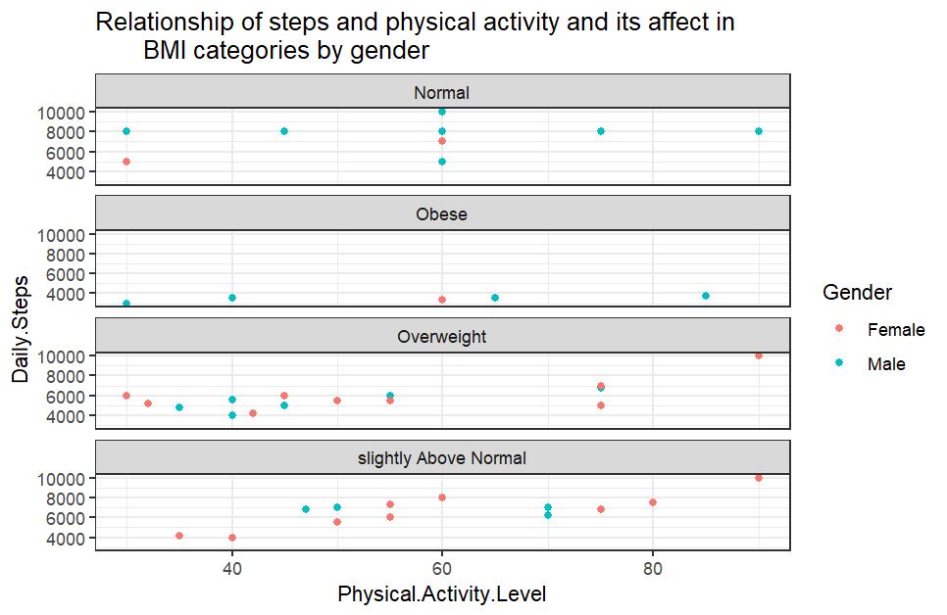
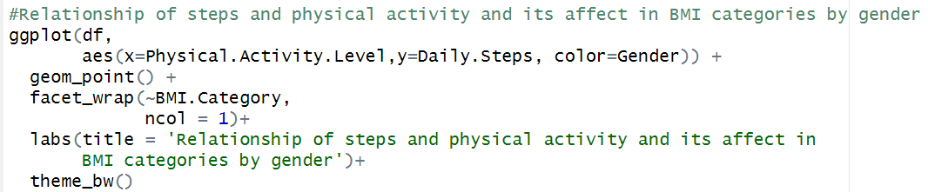
13.Relationship of steps and physical activity and its affect in BMI categories by gender

Slide 22
Conclusion:
1. As daily hours or sleep increases the quality of sleep also increases hence there’s positive relation between hours of sleep in individual and quality of sleep.
2. There is strong correlation between high blood pressure and higher heart rate in men.
3. More than 20 % of the participants belong to the age group 45 and 50 % participants belong to the age group 30 to 40.
4. As age increases the daily hours of sleep also increases and there’s non linear association between age and daily sleep.
5.Engineers are getting most daily hours sleep followed by lawyer and doctors while sale persons are getting the least sleep

Slide 23
Conclusion:
6. There’s high correlation between nurse and sleep apnea it means nurses are most likely to suffer from sleep apnea followed by the correlation between salesperson and insomnia.
7. The most overweighted category is Nurse followed by teacher and salesperson and the occupation which has most obese individuals is doctor.
8.Females are more prone to weight gain as there’s correlation between ‘overweight’ and female gender.
9.Participants with obesity has the lowest count for daily walking steps.
10.Female scientist and male sales representative have the most stressful lifestyles where as female doctors, engineers and male engineers, lawyers have the least stressful lifestyle.

Slide 24
Conclusion:
11. For stress level 7 and 8 heart rates are high indicating high stress level relates to high heart rate. Eg: female scientists have stress level of 8 and heart rate above 80.
12. For insomnia most points lies between 6 to 7 hours indicating less sleep and within it the most occurred occupations are Teacher and Salesperson from age group 40 to 45.
For sleep apnea most points lies between 6 to 7 hours indicating less sleep and within it the most
Occurred occupation is Nurse from age group 50 to 60.
13.For obesity most values lied below 4000 step for both genders with physical activity ranging 30 to 80.
For overweight most values lied between 4000 to 6000 steps for both genders with most values lying before 60 minutes of physical level.

Slide 25
Methods used is EDA
DATA IMPORTING
DATA PREPROCESSING
DATA VISUALIZATION
UNI AND BIVARIATE ANALYSIS

Slide 26

Thanks!
Please keep this slide for attribution

